Slide 1

IdeaQuest 2025 where groundbreaking solutions meet cutting-edge technologies
AI Catalysts

Slide 2




IdeaQuest 2025 – Team AI Catalysts
Snehal Bhasakhetre
Innovation and Technology
Product Architect 2
Bengaluru sbhasakhetre@deloitte.com
Yash Dixit
Strategy & Analytics
Consultant
Bengaluru ydixit@deloitte.com
Harshita Mehta
Strategy & Analytics
Consultant
Gurgaon
harshitmehta@deloitte.com

Slide 3
Provide Solution Approach
Selected Problem Statement: Spatial Planning Optimization: Currently, we lack the ability to predict and model process or construction changes within 3D location and simulation models, which leads to a reactive approach when determining spatial needs and equipment requirements. Utilize AI techniques such that we can enable more proactive spatial planning and simulation.
State the Solution Approach:
Our solution addresses a critical industry need - the lack of predictive spatial and operational planning in port and warehouse environments. Users can manually input parameters. These inputs-such as container count, crane/truck availability, stack height limits, time/fuel constraints, and so on are converted into a structured model for simulation.
Powered by Salabim, and PyOpenGL, our agentic Al simulates multiple "what-if" operational scenarios in a 3D virtual environment. It identifies optimal configurations and, when constraints cannot be met, automatically recommends revised parameters-enabling proactive planning and rapid scenario testing.
Scalable, reusable, and adaptable across industries, this solution provides a level of real-time intelligence and simulation depth not currently offered by traditional WMS or ERP systems.
It is designed for logistics operators, port authorities, warehouse planners, and large-scale industrial asset managers seeking intelligent optimization. Its originality lies in unifying spatial simulation, constraint solving, and agentic Al into a single operational decision-support system.

Slide 4

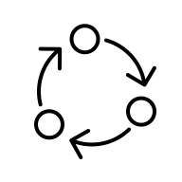







Technical Flow reference
Port Warehouse Operations Management System
Simulation feedback system
Data Sources
Interpret, Ingest, Transform
Agentic AI Management
Simulator data persistence
Operational Introspection Agent
User defined Parameters
Queries with Parameters
Intent Classifier for Routing to different Agent types and maintain topic focus
Multi-Agent Routing Classifier
LLM
Media and Result Storage
Simulation media
Optimization Metrics
Operational Metrics
External Data Sources
The process ends once the user approves the simulation and its constraints.
FlexSim
Simulation Business Logic Agent
External Sources Transformer
Oracle SCM/ERP
Data mapper based on the source type
Initiate Parameter Processor
Set up optimized schedules for trucks, cranes, and workers factoring in time, 3D space, material, and equipment restrictions, by considering equipment-level quality control checks after specified durations.
Run simulations and preserve the analysis outputs as videos in 3D warehouse layout formats for better interpretability.
SAP EWM/TM
Convert to the custom simulation machine readable format
Establish the warehouse structure in line with constraints concerning storage blocks, containers, roads, and space.
Begin container inventory control by generating outbound container orders at deterministic time intervals, using inter-arrival times to simulate real-world truck arrivals.

Slide 5
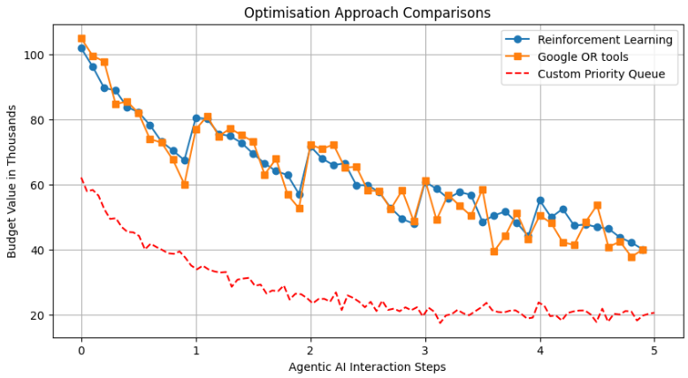
Simulation Optimization Approaches

Slide 6
Simulation Performance Metrics for the current application layout
AWS Instance metrics
Instance type - t2.small
CPU - 1vcpu
Memory - 2GiB
Pricing - $0.023 per hour, or $16.79 per month
Simulation metrics for
Maximum number of runs - 10 simulations per user session(at 10000x speed)
Number of containers – 687 containers
Warehouse coverage – 117,600 m² (1,266,217 ft²)
Performance metrics at different speeds for simulation completion (Best Case Scenario)
At 10000x speed
Time Take - ~45 seconds
MP4 file size – ~4.5MB
At 1000x speed
Time Take - ~6 minutes
MP4 file size - ~27.5MB

Slide 7
Tech Stack
Streamlit - Interactive user interface for input configuration and real-time simulation feedback
LangChain - Hosts Agentic Al for intelligent decision orchestration, parameter tuning, and user Interaction
Salabim – 3D-event simulation for modelling container flow, equipment usage, and labor dynamics
PyOpenGL - 3D visualization of port layouts and simulation outcomes
AWS Batch - Scalable compute for running simulation workloads in parallel
AWS Lambda + Step Functions - Orchestrates ingestion and transformation of data from enterprise tools (SAP, Oracle, FlexSim)
Amazon S3/DynamoDB - Stores RAG Data, structured simulation inputs, results, and enterprise metadata
Amazon RDS – Stores user metadata and activity
Streamlit graphical extensions - Enables analytics, displays simulation results, and reporting dashboards
Amazon ECS (EC2/Fargate) - Optional service layer for micro-tasks or lightweight processing, and spinning up the UI and batch processes
Amazon ECR - Docker container image store
AWS IAM, CloudWatch, Secrets Manager - Provides security, observability, and credential management

Slide 8

























Technical Architecture Diagram
Virtual private cloud (VPC)
Data Tier
ML Operations
Lambda functions to convert enterprise data to a relevant format
Users
Application Load Balancer
Sagemaker Notebooks for analysis and getting the production code ready
Amazon S3 (Agentic Data Source)
Lambda function to generate LLM response (Router)
Public subnet
AWS CodeCommit to maintain code versioning
Amazon ECR for application and simulation images
Amazon DynamoDB for chat history and interaction metadata store
AWS Batch to trigger simulation operations and retrieve simulation results
Streamlit app hosted Auto-Scaled ECS EC2
Instance/s
Amazon API Gateway
Private subnet
AWS CodeBuild to maintain code and model artifacts in S3
Batch simulation tool
Amazon RDS
AWS CodeDeploy to deploy the models fronted by Sagemaker model endpoints
Simulation N
Email notification
Amazon SNS
Amazon EventBridge
…
MySQL
User Database
Simulation 2
Functional flows
The user accesses the system and inquires about available tools via the chat interface. After identifying the required tools, the user specifies simulation parameters in natural language, which are then parsed and converted into a JSON-compatible format for processing. AWS Batch then initiates simulations based on these parameters. Upon completion of the simulation, the user receives an email notification and a natural language summary from the AI agent, including the requested statistics and relevant simulation details.
User interactions and simulation data are maintained in DynamoDB and S3.
User prompts are handled by Langchain, which delivers appropriate responses using the multi-agentic data source.
Simulation 1
MySQL
User Metadata Database
AWS CodePipeline to maintain the DevOps process
EC2 Instance
Amazon CloudWatch to maintain logs, model metrics and triggering events

Slide 9
Scalability, Reusability, and Industry Impact
Scalable Architecture and Reusability Across Industries
The solution is built on a serverless, modular, scalable and configurable agentic Al architecture, enabling deployment across diverse sectors such as maritime logistics, air cargo hubs, defense logistics, and industrial warehousing.
Plug-and-play simulation design allows for rapid reconfiguration across various layouts, equipment types, and operational constraints, supporting ease of customization.
Reusable optimization logic for scheduling, equipment allocation, and spatial planning enables accelerated development of future deployments and client solutions.
Cross-Industry Relevance and Market Potential - The logistics and warehousing sector is undergoing rapid digital transformation:
Logistics Automation Market projected to reach $147.4 billion by 2030, with a CAGR of 11.9% (Allied Market Research).
Al in Warehousing expected to reach $45.12 billion by 2030, growing at a CAGR of 26.1% (Grand View Research).
Industry leaders are pushing for Digital Twins and predictive AI, but many are still in the exploratory phases – giving our solution a first-mover advantage.
Return on Investment and Operational Value - Demonstrates clear efficiency gains, including (Sources - DHL, IBM, McKinsey, FlexSim, AnyLogic, Arena):
10-25% increase in operational throughput
15% or more reduction in fuel and energy consumption
20-30% reduction in downtime through proactive scheduling and maintenance simulation by avoiding RTG crane idle time and worker mismatch
For a small to medium port, estimated annual savings of $1 million or more per major port facility, based on optimized equipment use and reduced turnaround time.
Enables proactive what-if based planning, empowering leadership to make data-driven infrastructure and workforce decisions ahead of demand.
Interoperability with Enterprise Systems (Future Scope)
Designed to integrate seamlessly with enterprise platforms such as FlexSim, Oracle SCM/ERP, and SAP EWM/TM through structured data exchanges using CSV, XML, and API endpoints.
Supports bi-directional data flow, allowing the system to not only ingest operational data but also export optimized configurations (e.g., schedules, routing strategies, container placement plans) back to enterprise systems.
Incorporates automated ETL pipelines (Python-based using Pandas, NumPy) to convert business metrics into simulation-ready inputs and reformat Al-generated outputs for downstream enterprise use.

Slide 10
Assumptions
Consistent Infrastructure Layouts – It is assumed that the warehouse layout—including elements such as road widths, container zones, and entry or exit points—remains unchanged and is precisely specified before each simulation. To maintain model accuracy, we ensure the layout stays constant throughout the simulation. Any changes to the layout mid-simulation could reduce accuracy, potentially resulting in unrealistic movement routes and improper allocation of resources.
Operational Rules and Constraints Are Defined – Parameters like crane capacities, stacking height limits, routing procedures, and timing restrictions are established in advance and remain unchanged during the simulation. If these rules were to change mid-simulation, it could create logical inconsistencies, making operational plans unworkable in practice. Applying this approach in real-world situations could result in either slight overestimating or slight underestimating the actual resources needed.
Preassigned Skill-Role Mapping for Workers – Each worker’s role and skill set (such as RTG operation or maintenance) is explicitly designated in advance, with no need for dynamic reassignment or skill adaptation during the simulation. This ensures the simulation assumes every worker is fully competent in their assigned tasks.
Simulation Time Reflects Realistic Operations - The virtual simulation is assumed to reasonably reflect actual process timings, queueing, handling speeds, and downtime. For example, decommissioning of an RTG due to maintenance activity.
Users Possess Domain Knowledge – It is assumed that users, such as port planners and logistics managers, have a solid understanding of operational constraints and can set appropriate objectives and trade-offs. If this assumption does not hold, there is a risk that the tool could be misused or misunderstood, potentially resulting in ineffective optimization runs and reduced ROI. To address this, future enhancements could include AI-driven guidance, onboarding modules, and best practice templates to support users and enhance usability.
Actionable Feedback Loop – The assumption is that the optimization results and updated parameters produced by the agentic AI can be integrated into planning or operational processes. If these recommendations are not adopted as provided, there is a risk of missing out on optimization benefits and diminishing the overall value of the system.
Worker Simulation Scope – Human worker interactions (e.g., walking, machine handling) will not be fully animated in the 3D simulation due to the humanoid joints’ complexity and time constraints. But the analytics with respect to the worker schedule will be shown in detail.
Physics Simplification – Variations in individual container weights are not currently factored into the simulation dynamics. This may lead to a slight compromise in simulating real-world physics – for example, truck speeds won’t vary with load weight

Slide 11
Thank You

